Slide 1
Cromarty Youth Café Report for Community Council
April 2023

Slide 2
Numbers
Young People - 224
Learning Hours - 531
Programmed Activities – 36

Slide 3
Cromarty Youth Café Easter Programme 2023
Day | Date | Activity | Age | Time
Monday | 3rd April | Multi-Sports | 5+ | 10am - 12noon
Monday | 3rd April | Outdoor Rowing | 12+ | 12:30pm - 2.30pm
Tuesday | 4th April | Rugby | 5+ | 1pm - 2pm
Wednesday | 5th April | Creativity in Care Intergenerational Session | 10+ | 10:30am - 12:30pm
Wednesday | 5th April | Tennis Coaching | 5+ | 10am - 12noon
Wednesday | 5th April | Residential to Fairburn | 13+ | 4pm - on Wed
Thursday | 6th April | Tennis Coaching | 5+ | 10am - 12noon
Thursday | 6th April | Residential to Fairburn | 13+ | All Day
Friday | 7th April | Residential to Fairburn | 13+ | 1pm on Fri
Friday | 7th April | Tennis Coaching | 5+ | 10am - 12noon
All activity except the residential are FREE , Refreshments will be provided at every activity. To book any activities please contact Fraser – 07908465593 Please contact Vicky on – 07810046323 for the Tennis Coaching

Slide 4
Easter Programme 2023
Young people reported to us that the Easter Programme was amazing
This programme was funded by the Highland Council Cost of Living Fund
Lots of fun activities for young people
120 young people took part in a range of activities.
Over 300 hours of learning hours
15 different programmed activities
At every activity young people were served with a range of hot or cold meals and a range of refreshments.

Slide 5
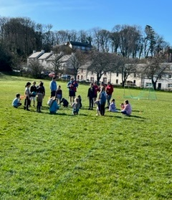
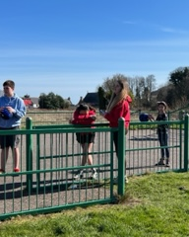
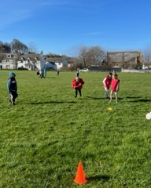
Multi-Sports
FamilyID=Office_ArchiveTorn

Slide 6
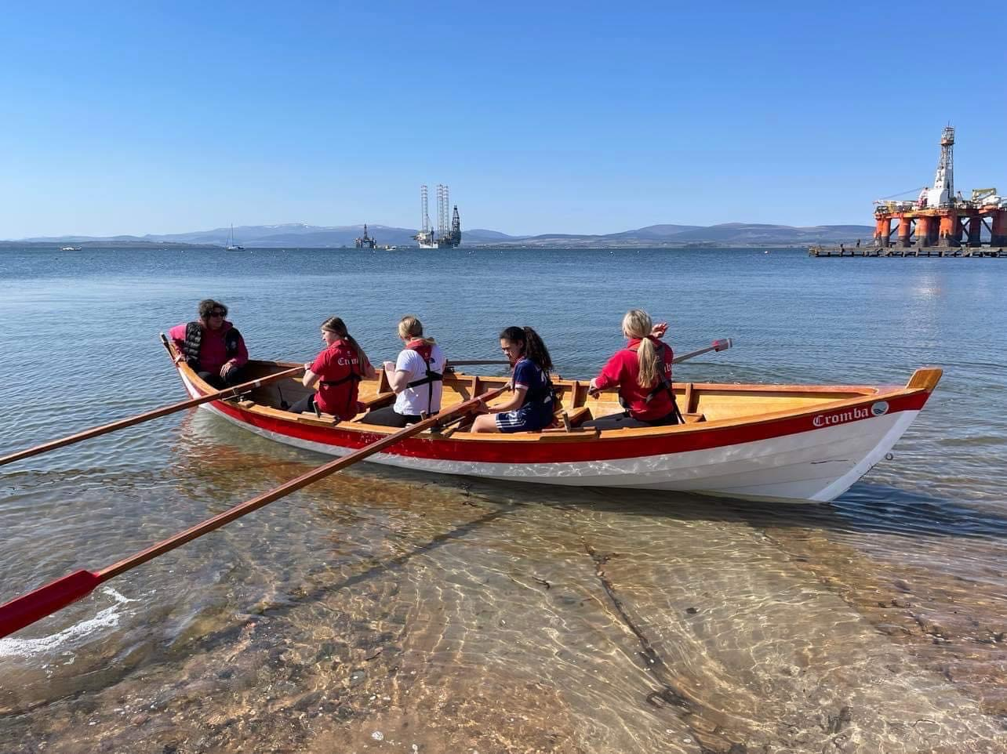
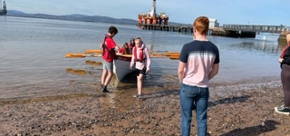
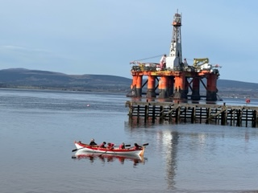
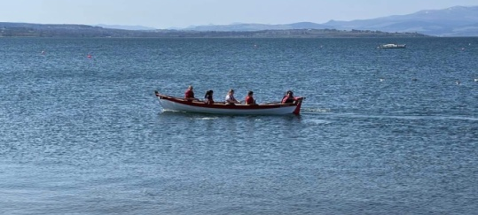
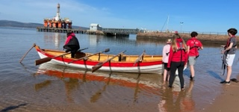
Rowing with Cromarty Community Rowing Club, Young people enjoy their show & row session’s

Slide 7
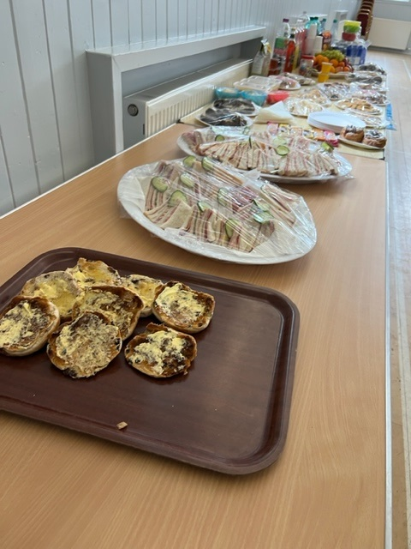
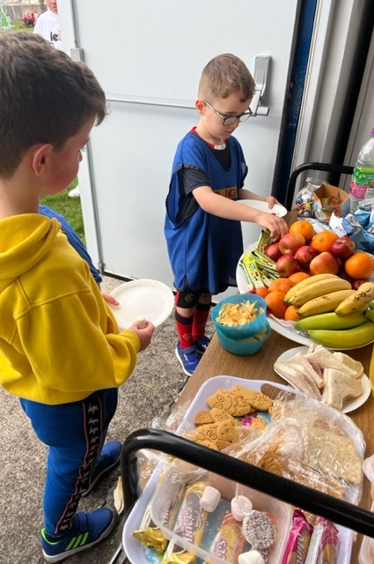
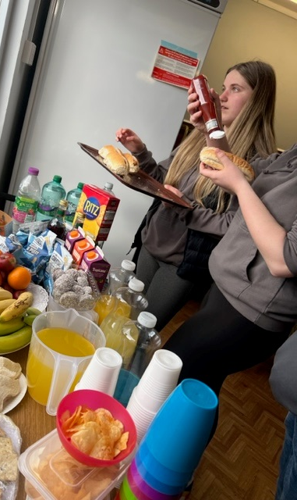
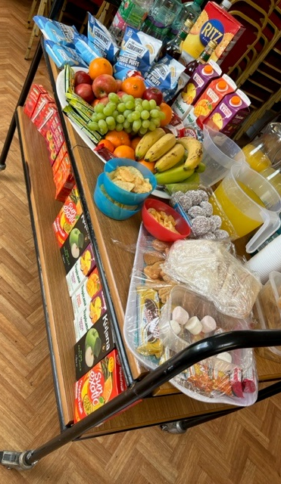
THE FOOD - with funding from HC Cost of Living Funding All participant were enjoyed a range of hot, cold meals along with a range of healthy wholesome snacks – Young People tell us the food is one of the BEST parts about attending our activities

Slide 8
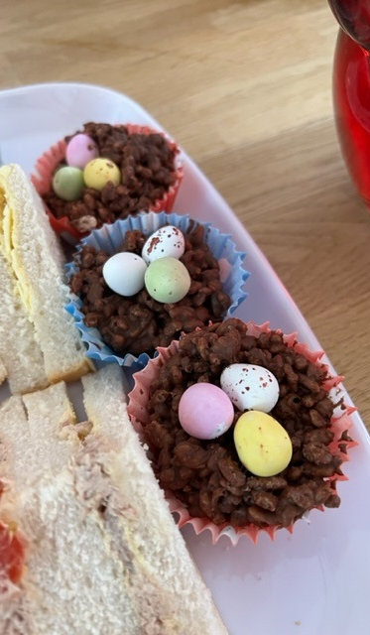
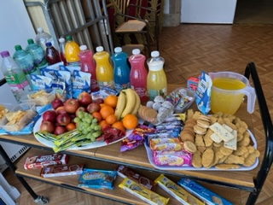
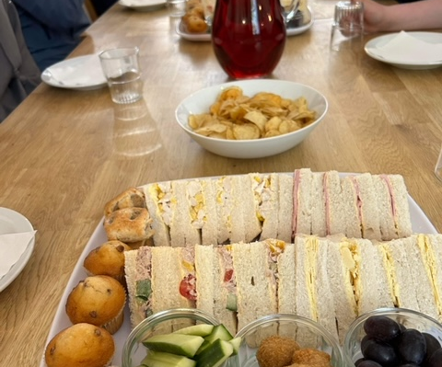
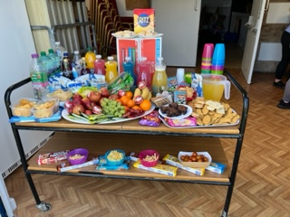
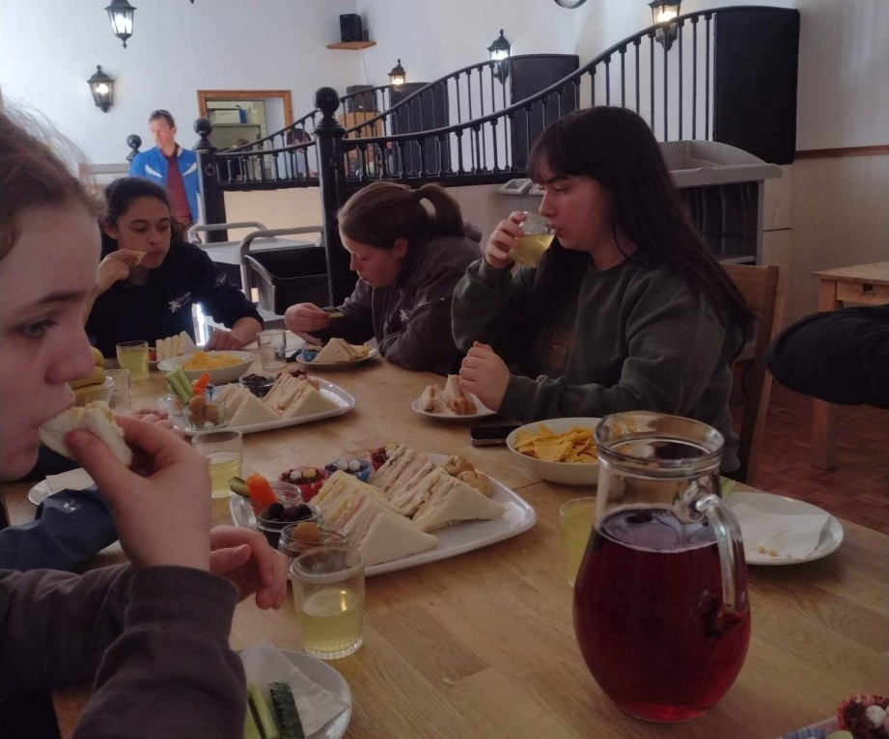

Slide 9
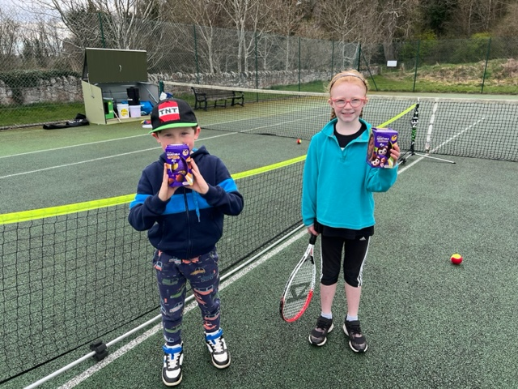
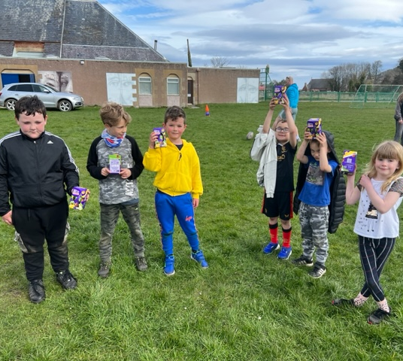
Spreading easter cheer - every person who attended our activities were given a chocolate egg

Slide 10
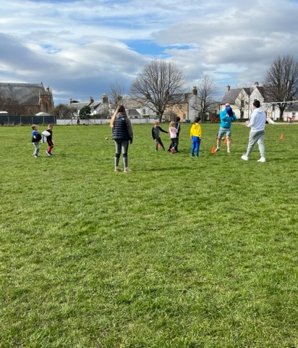
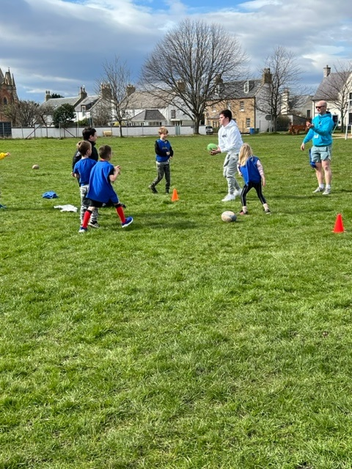
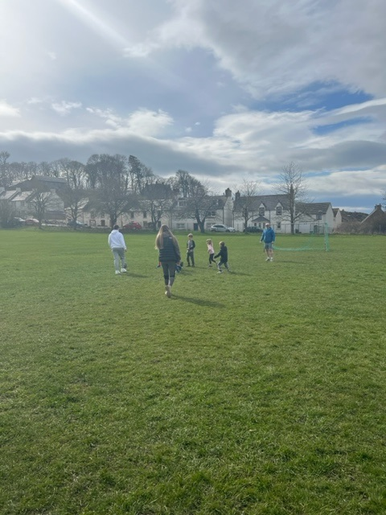
Rugby Coaching skills & drills and fun with HLH Active Schools Coordinator
FamilyID=Office_ArchiveTorn

Slide 11
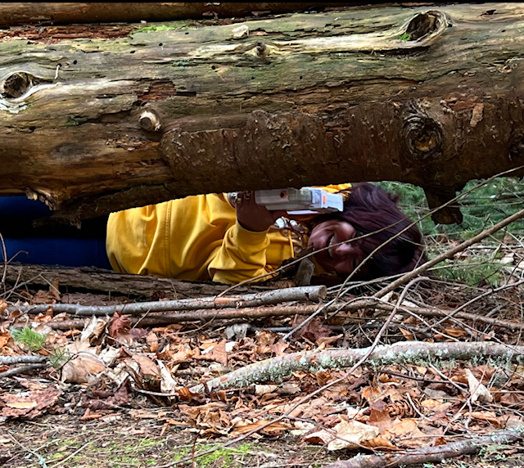
Residential to Fairburn Activity Centre
The feedback from the young people was that:
The residential to Fairburn was an amazing experience
Some young people had never had the experience of a residential.
Activities we took part in:
LaserTag
Archery
Jacobs Ladder
Crate Stacking
Mountain Biking
Bubble Football,
Football
Card Games
Twister
52 Card Pick up
Don’t Fall Down
Walk & Talk in the Woods
CTL Level 4
Achievement & Leadership

Slide 12
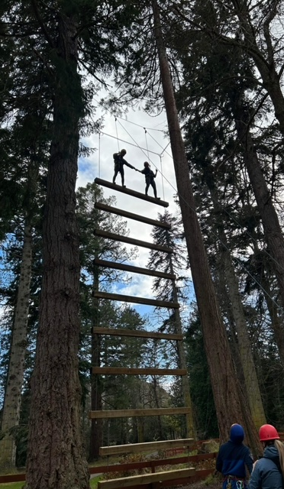
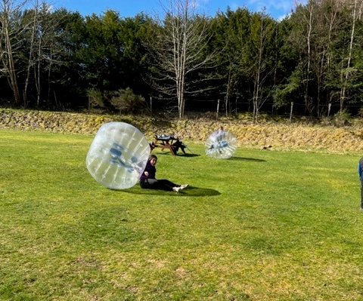
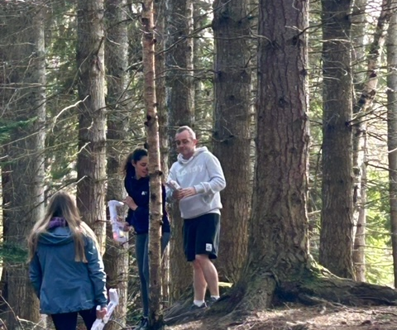
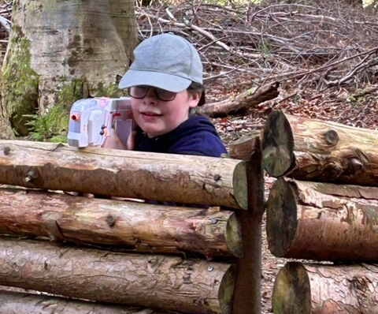
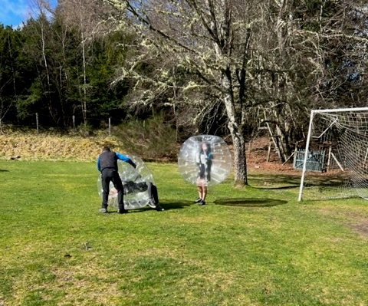

Slide 13
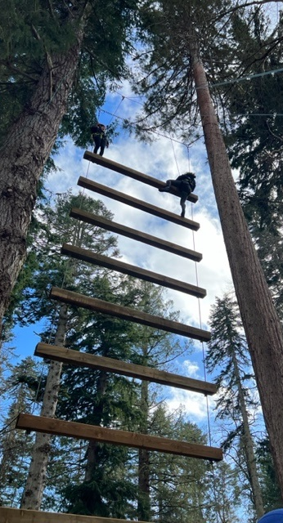
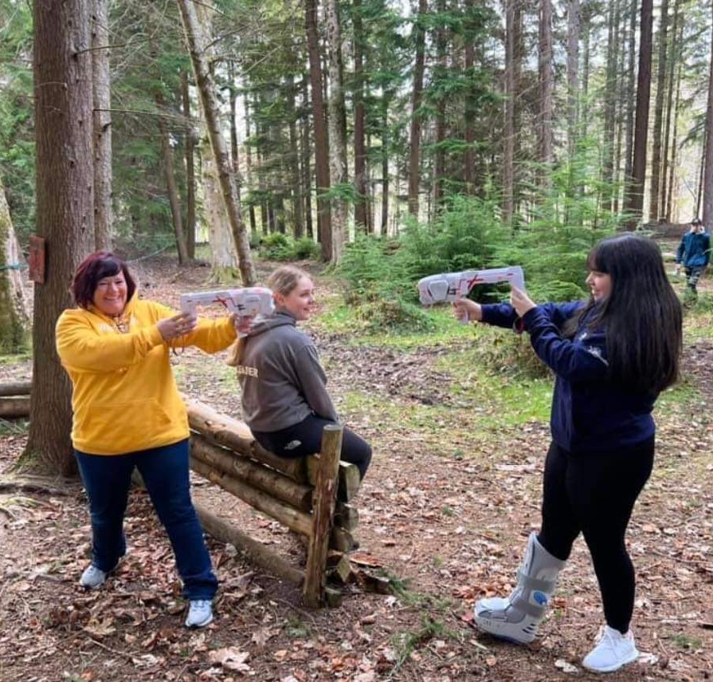
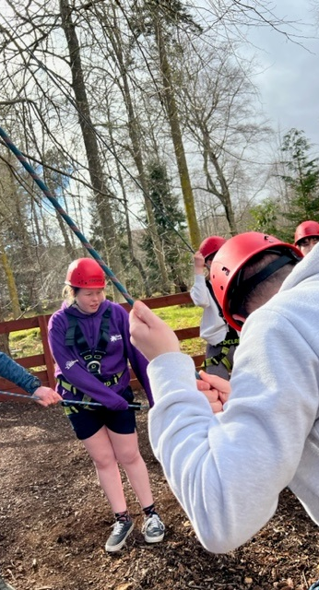

Slide 14
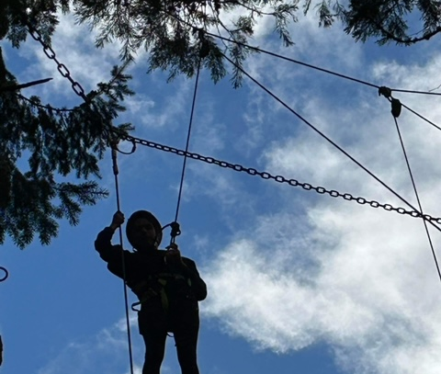
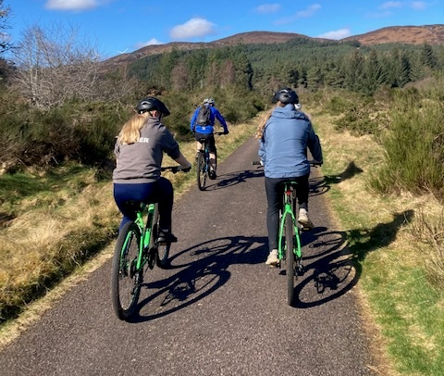
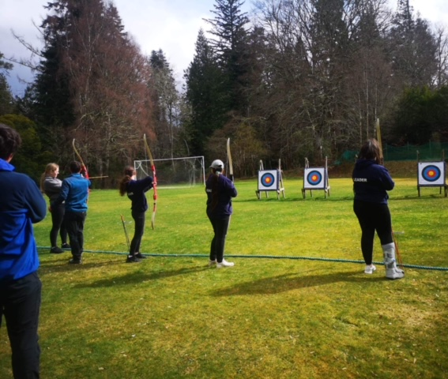
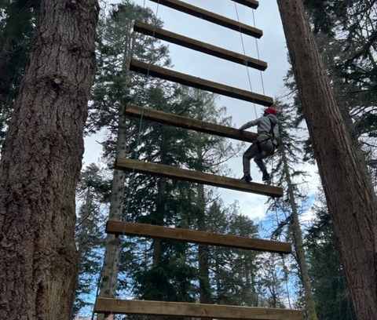

Slide 15
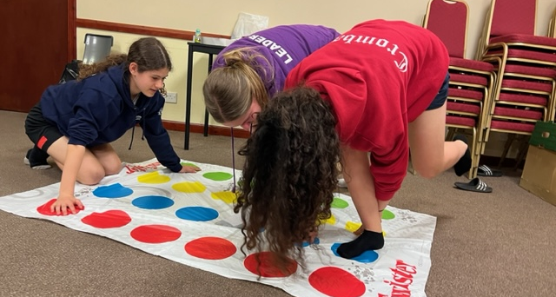
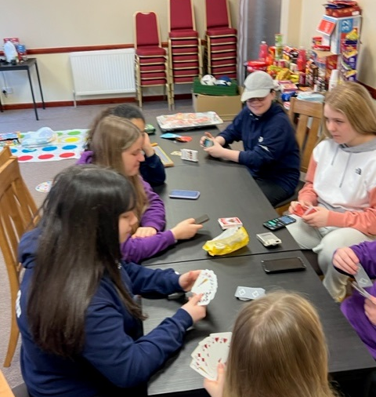
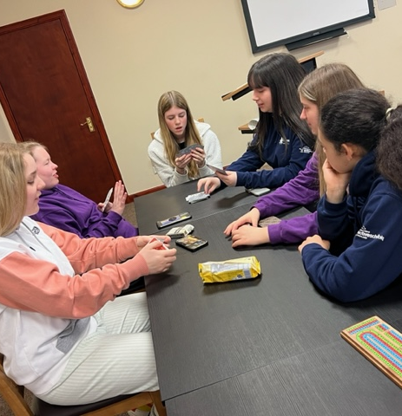
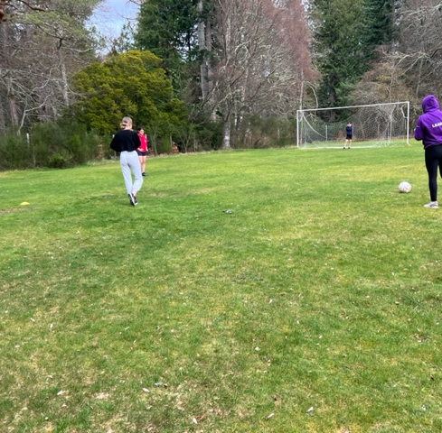

Slide 16
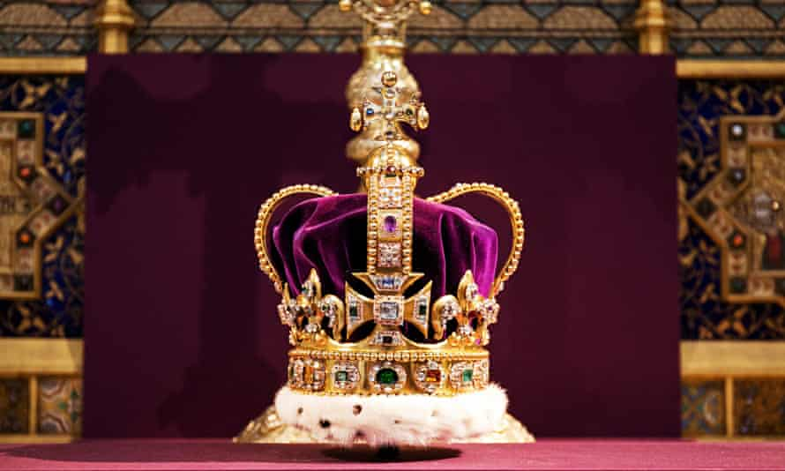
Kings Coronation Planning:
Young people have planned the King’s Coronation Community event for young people as part of their Inspire 2022 project with Youth Scotland. We will celebrate this once or twice in a lifetime event together and have fun. Our sense of community will strengthen, and we will meet new people. One of the activities we have planned is a time capsule, as we want to capture the memories of this specific moment in history, and what life is like on the Black Isle at this time.
The young people have planned all the activities and will be running them on the day. They’ve chosen these fun activities to reflect the excitement of the Coronation and have linked them to the Royal traditions of the past and present.
Here are some of the activities we are planning for the day:
• Bouncy Balmoral Castle • The Royal Piper • The Highland Dancer • Inverness Caley Thistle Football – beat the goalie, fun games, skills and drills • Dressing up, Face painting and Tattoos (Allergy Free) • Omnikin Ball fun • A banquet fit for a King for our young people • Lawn Tennis • Cromarty Fire and Rescue Service with their fire truck – tours inside • The Royal Portrait Fun Photo Booth • Kings Crowns design and decorate • Singing the Cromarty Song • Hook a Royal Duck • Dressing up parade like little princes and princess or perhaps the Royal Dog

Slide 17
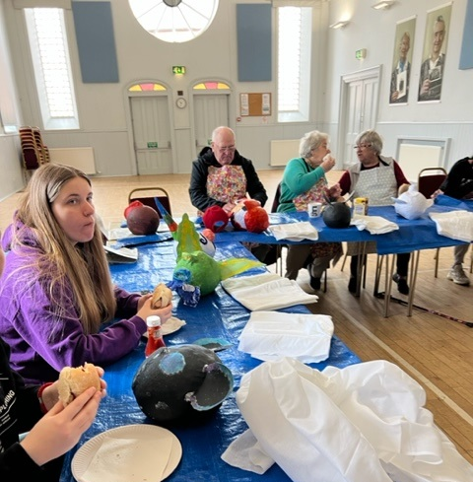
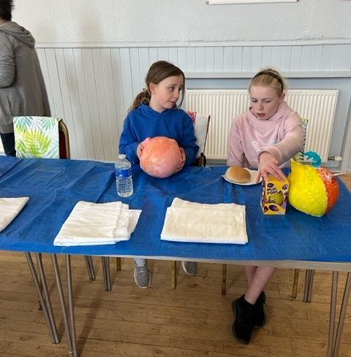
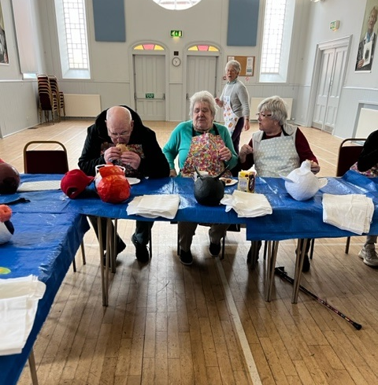
Creativity in Care Workshop’s
Talking about death & Dying. Good Life, Good Death & Good Grief
Younger and older people are creating puppets that hold emotions later In the year we hope to create a puppet theatre.
The group are learning a range skills while creating the puppets and they are simply amazing,

Slide 18
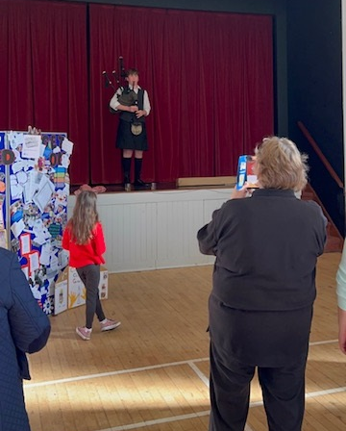
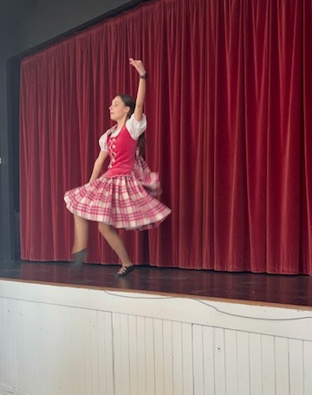
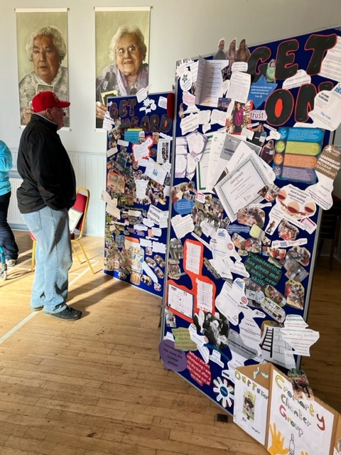
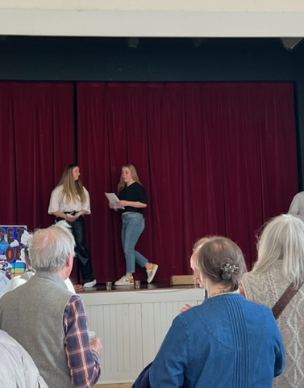
Middleton Trust Anniversary Celebration
Biggest thanks to Orlagh & Loreta for their Amazing presentation about how Youthwork has changed their lives at Cromarty Youth Cafe
To Alistair Fox for playing his Bagpipes To Iona Browne for her Highland Dancing To Georgia McDonald for her Beautiful harp playing 😎
You guys sure did evoke a few emotions
We cannot be prouder of you all just an absolute pleasure to see you guys grow in confidence we are blessed
Biggest 🙏 go to our Young people for creating our story boards about their journey through Youthwork supported by the Middleton Trust over the last 10 years
Last but certainly not least a Massive thank you to the Middleton Trust for their support to us at Cromarty Youth Cafe.
Great to see the other recipients of MT funding showcasing their work.
#youthworkchangeslives
#communityspirit

Slide 19
Supporting Families in Need
With funding from various different sources:
MFR Cost of Living emergency grants – 31 young people helped with Food & Fuel Vouchers
Highland Council Cost Of Living Tesco Vouchers: £500 worth of vouchers purchased and given to families – 64 ppl helped.
Corra Foundation –8 families receive £50 vouchers for Tesco for food shopping & a £50 vouchers for the post office to purchase electric each month from Jan 2023 – July 2023

Slide 20
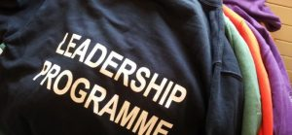
Highlife Highland Leadership Programme
At the end of March we had the Lord Lieutenant come and present various different Highlife Highland Leadership Progamme Hoodies to young people ranging from:
Navy for 25 hours of Leadership
Purple for 50 hours of Leadership and completing 2 wider achievement courses
Silver for 250 hours of Leadership
Gold for 500 hours of Leadership

Slide 21
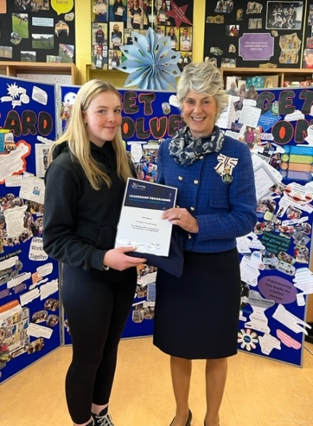
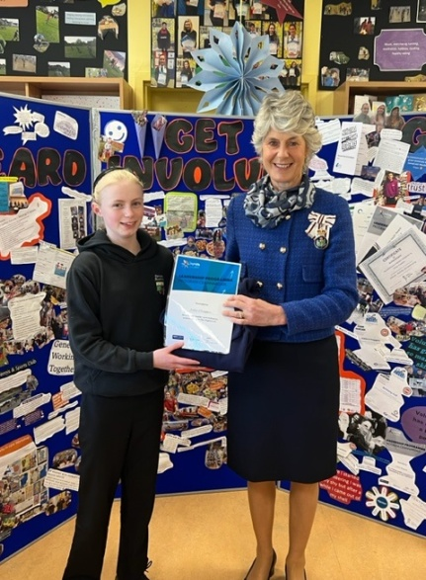

Slide 22
Choose To Lead Level 4
Orlagh was the 2nd person in Youth Work to pass this course
We applaud 👏 Ella Patience for her Outstanding Contribution to HLH Leadership Ella is the first ever Fortrose Academy HLH young leader to Complete her Choose to Lead Level 4 SCQF with Our Youthwork team , in partnership with HLH and UHI Inverness 👏👌.

Slide 23
Black Isle Place Plan Meeting in Fortrose Academy
Planning Meeting with Becky Richmond – about the Black Isle Place plan with young people. Informative session on 20th March
We welcomed Becky and Eilidh back in the Youth work classroom on Thursday 20th April at 1pm, for them to hear the voices of young people.
Young people created a poster for this event and they facilitated this event
Homebaking and Refreshments were enjoyed by everyone who attended

